Slide 1
Who needs design patterns anyway?
Toni Petrina
@to_pe
Synergy, GigPin, Microsoft MVP

Slide 2


Slide 3
Agenda
Topic introduction
SOLID
Command pattern
Creation patterns (DI, IoC, Factory)
Organizational patterns
Wrap up

Slide 4
What exactly are patterns?

Slide 5
Definition
A design pattern systematically names, motivates, and explains a general design that addresses a recurring design problem in object-oriented systems. It describes the problem, the solution, when to apply the solution, and its consequences. It also gives implementation hints and examples. The solution is a general arrangement of objects and classes that solve the problem. The solution is customized and implemented to solve the problem in a particular context. Design Patterns by Gamma, Helm, Johnson and Vlissides (360)

Slide 6
When to use them
When it fits
During:
Refactoring
https://github.com/emilybache/GildedRose-Refactoring-Kata/blob/master/csharp/GildedRose.cs
Architecting
https://gist.github.com/lolzballs/2152bc0f31ee0286b722
https://github.com/EnterpriseQualityCoding/FizzBuzzEnterpriseEdition/
interface IHelloWorld{
 | public IHelloWorldString getHelloWorld();
 | public IPrintStrategy getPrintStrategy();
 | public IStatusCode print(IPrintStrategy strategy, IHelloWorldString toPrint);
 | }

Slide 7
SOLID
Single responsibility principle
Open/close principle
Liskov substituion principle
Interface seggregation principle
IReadable, IWriteable instead of IEntity
Dependency inversion principle

Slide 8
How do we teach them?
DRY, YAGNI, KISS, SOLID
Sandi Metz: Duplication is far cheaper than wrong abstraction

Slide 9
Command pattern

Slide 10
// View.xaml <Button Content="Click me" x:Name="btn" />
// View.xaml.cs btn.Clicked += btn_Clicked;

Slide 11
// view.html
<button id="btn">click me</button>
// view.js
$("#btn").click(function () {
//
})

Slide 12
// View.xaml
<Button Content = "Click me" x:Name="btn" />
// ViewModel.cs
class ViewModel
{
public void OnBtn() { }
}
// View.xaml.cs
private ViewModel VM;
btn.Clicked += (_, __) => VM.OnBtn();

Slide 13
// View.xaml
<Button Content = "Click me" x:Name="btn" />
<Button Content = "Click me" x:Name="btn2" />
// View.xaml.cs
private ViewModel VM;
btn.Clicked += (_, __) => VM.OnBtn();
btn2.Clicked += (_, __) => VM.OnBtn2();
// ViewModel.cs
class ViewModel
{
public void OnBtn() { }
public void OnBtn2() { }
}

Slide 14
// Controller
public IHttpActionResult Action(string id, int param)
{
return Ok(service.DoAction(id, param));
}
// Service
public DTO DoAction(string id, int param)
{
using (unit of work)
{ }
}

Slide 15
// View.xaml
<Button Content = "Click me" Command="{Binding OnBtn}" />
// View.xaml.cs
DataContext = new ViewModel();
// ViewModel.cs
class ViewModel
{
public void OnBtn() { }
}

Slide 16
Problems with this approach
Too much coupling
Inability to filter, log, reject, cache commands
Some are cross cutting concerns
How to perform incidental actions
Notifications, logs, validation, cache invalidation

Slide 17
void foo(string url)
{
var client = new HttpClient();
var json = await client.GetString(url);
var model = await Deserialize<Model>(json);
}

Slide 18
async void foo(string url)
{
try
{
var client = new HttpClient();
var json = await client.GetString(url);
var model = await Deserialize<Model>(json);
}
catch (Exception ex)
{
Logger.Log(ex);
}
}

Slide 19
// progress
async void foo(url)
{
if (IsDoing) return;
try
{
IsDoing = true;
var client = new HttpClient();
var json = await client.GetString(url);
var model = await Deserialize<Model>(json);
}
finally
{
IsDoing = false;
}
}

Slide 20
// GA??
async void foo(url)
{
var client = new HttpClient();
var json = await client.GetString(url);
var model = await Deserialize<Model>(json);
GA.SendEvent("did", "something", "now", 1);
}

Slide 21
// throttle?
sendVolumeDownAsync("speaker1");
sendVolumeDownAsync("speaker1");
sendVolumeDownAsync("speaker1");
sendVolumeDownAsync("speaker1");

Slide 22
// ideally
Action foo_final = compose(
validate,
progress,
GA,
foo
);

Slide 23
final foo
try
{
}
catch{}
try
{
}
finally
{
}
GA
foo

Slide 24
Invocation
No direct invocation!
Use pipeline for that
Dispatch(new Command());
We get undo/redo stack for free!

Slide 25
Anybody really doing this?
Redux – predictable state management on the frontend
Flux – entire pattern and all associated libraries
ASP.NET Core – middlewares for handling HTTP requests
Phoenix

Slide 26
public interface ICommand
{
void Execute();
}

Slide 27
public interface ICommand2
{
bool CanExecute();
void Execute();
}

Slide 28
public interface ICommand3
{
bool CanExecute(object o);
void Execute(object o);
}

Slide 29
public interface IAsyncCommand
{
Task Execute();
}

Slide 30
public class AsyncCommand : IAsyncCommand
{
public async Task Execute()
{
}
}
AsyncCommand cmd;
var t1 = cmd.Execute();
var t2 = cmd.Execute();

Slide 31
public class AsyncCommandNoConcurrent : IAsyncCommand
{
Task task;
public Task Execute()
{
if (task == null)
{
task = Do();
task.ContinueWith(t =>
{
task = null;
});
}
return task;
}
async Task Do() { /* ... */ }
}

Slide 32
public class AsyncCommandOnce : IAsyncCommand
{
Task task;
public Task Execute()
{
if (task == null)
task = Do();
return task;
}
async Task Do() { /* ... */ }
}

Slide 33
Creational patterns

Slide 34
Separate object creation from consumption
DI
replaces new in constructor for unique objects
IoC
replaces new in methods for unique objects
Factory
replaces new for non-unique objects

Slide 35
// DI container
class Container
{
Dictionary<Type, object> cache;
public void Register<TInterface, TClass>(TClass instance)
{
cache.Add(typeof(TInterface), instance);
}
public TInterface Get<TInterface>()
{
return cache[TInterface];
}
}
public class Bar
{
public Bar(IService service = null)
{
this.service = service ?? Container.Get<IService>();
}
}

Slide 36
public class Factory<T>
{
public T Create() => new T();
}
public class FooFactory
{
public Foo Create(int id) => new Foo(id);
}

Slide 37
Why use DI/Factory
For mocking, testing, etc…

Slide 38
public interface IMailSender
{
void Send(string subject, string to, string content);
}
// equivalent to…
public delegate void SendMailDelegate(string subject, string to, string content);

Slide 39
public class Foo
{
public Foo(IService service = null) { }
public void Do() => service.Do();
}
// same as
Action<IService> FooDo =
service => service.Do();

Slide 40
// same as
Action<IService> FooDo =
service => service.Do();

Slide 41
// same as
Action<IService> FooDo =
service => service.Do();
var service = new Service();
Action ServiceDo = () => FooDo(service);

Slide 42
// same as
Action<IService> FooDo =
service => service.Do();
var service = new Service();
Action ServiceDo = () => FooDo(service);
public class Foo {
public Foo(IService service = null) { }
public void Do() => service.Do();
}
public class Bar {
public Bar(Foo foo) { this.foo = foo; }
public void Do() { foo.Do(); }
}

Slide 43
public interface IMessageQuery
{
string Read(int id);
}

Slide 44
public class FileStore : IMessageQuery
{
private readonly DirectoryInfo workingDirectory;
public FileStore(DirectoryInfo workingDirectory)
{
this.workingDirectory = workingDirectory;
}
public string Read(int id)
{
var path = Path.Combine(
this.workingDirectory.FullName, $"{id}.txt");
return File.ReadAllText(path);
}
}

Slide 45
Func<DirectoryInfo, int, string> read =
(workingDirectory, id) =>
{
var path = Path.Combine(workingDirectory.FullName, $"{id}.txt");
return File.ReadAllText(path);
};

Slide 46
Func<DirectoryInfo, int, string> read =
(workingDirectory, id) =>
{
var path = Path.Combine(workingDirectory.FullName, $"{id}.txt");
return File.ReadAllText(path);
};
DirectoryInfo root = new DirectoryInfo(Directory.GetCurrentDirectory());
Func<int, string> messageQuery =
(id) =>
{
var path = Path.Combine(root.FullName, $"{id}.txt");
return File.ReadAllText(path);
};

Slide 47
Func<DirectoryInfo, int, string> read =
(workingDirectory, id) =>
{
var path = Path.Combine(workingDirectory.FullName, $"{id}.txt");
return File.ReadAllText(path);
};
DirectoryInfo root = new DirectoryInfo(Directory.GetCurrentDirectory());
Func<int, string> messageQuery2 = id => read(root, id);

Slide 48
const int multiplier = 4.5;
// lambda
Func<int, int, int> calc = (x, m) => x * m;
calc(1, multiplier);
// closure
Func<int, int> calc2 = x => x * multiplier;
Assert.Equal(calc2(1), calc(1, multiplier));

Slide 49
// use closures to fix param
var workingDirectory = new DirectoryInfo(Environment.CurrentDirectory);
Func<int, string> read = id =>
{
var path = Path.Combine(workingDirectory.FullName, $"{id}.txt");
return File.ReadAllText(path);
};

Slide 50
// use closures to fix param
var workingDirectory = new DirectoryInfo(Environment.CurrentDirectory);
Func<int, string> read = id =>
{
var path = Path.Combine(workingDirectory.FullName, $"{id}.txt");
return File.ReadAllText(path);
};
public interface IMessageQuery
{
string Read(int id);
}
Func<int, string>

Slide 51
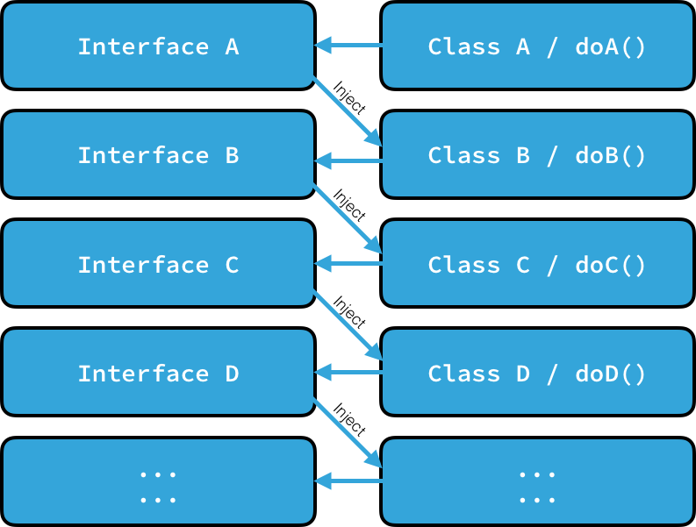

Slide 52
Functional equivalence
public void UpdateStudents(IStudentRepository repo, string name)
{
student.Name = name;
repo.UpdateStudent(student);
}
// So you want to test the above method, but you need to implement
// *EVERYTHING* in repository to make it work

Slide 53
Functional equivalence
public void UpdateStudents(string name, Action<Student> updater)
{
student.Name = name;
updater(student);
}
// So you want to test the above method...
public void TestUpdateStudents()
{
...UpdateStudents("John", _ => { })
}

Slide 54
Organizational patterns

Slide 55
MVC

Slide 56
MVP

Slide 57
MVVM

Slide 58
We have scaling issues

Slide 59
MVVM made simple
http://www.codeproject.com/Articles/278901/MVVM-Pattern-Made-Simple

Slide 60
MVC

Slide 61

User profile page
Compose post
Done
Back
UserProfileViewModel
NewPostViewModel

Slide 64
Redux
View
Action
Reducer
Store

Slide 65
class Counter
{
public int Value { get; set; }
}

Slide 66
class Counter
{
public int Value { get; private set; }
public void inc() { Value++; }
public void dec() { Value--; }
public void set(int val) { Value = val; }
}

Slide 67
// simple store
var store = new Store<int> ((state, action) =>
{
if (action is int) return (int)action;
if (action is string && (string)action == "+")
return state + 1;
if (action is string && (string)action == "-")
return state - 1;
return state;
}, 10);

Slide 68
static Func<Dispatcher, Dispatcher> Log<T>(Store<T> store)
=> next => action =>
{
Console.WriteLine($"Action {action.GetType()} started");
var result = next(action);
Console.WriteLine($"Action {action.GetType()} finished");
return result;
};
var store = Store<int>.CreateStore(
reducer,
initialState,
Store<int>.ApplyMiddleware(Log));

Slide 69
"It's not about the potential power of doing more, it's about exploiting the properties that you gain by doing less."
Cheng Lou

Slide 70
So, who needs design patterns anyway? - All of us!

Slide 71
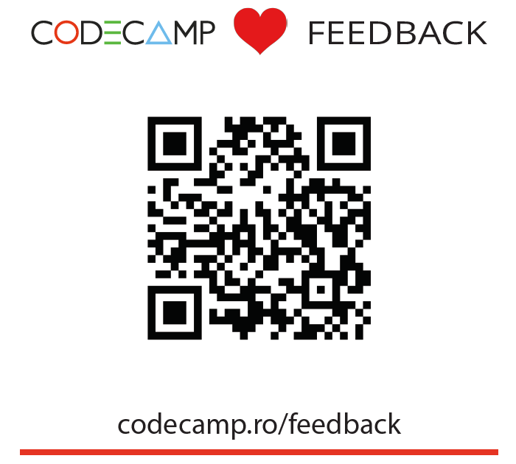
Toni Petrina
Massive Pixel d.o.o.
@to_pe
toni@massivepixel.co

Slide 72
Thank you!

Slide 73
Refactoring to Redux
class Account {
loadAccountInfo (accountId) {
isFetching = true
axios.get(`/api/accounts/${window.userState.accountId}`)
.then(r => {
isFetching = false
data = r.data
})
.catch(e => {
isFetching: false
alert('Error fetching account details')
})
}
}

Slide 74
Refactoring to Redux
loadAccountInfo = (accountId) => {
this.setState({ isFetching: true });
axios.get(`/api/accounts/${accountId}`)
.then(r => {
this.setState({ isFetching: false })
this.setState(r.data)
})
.catch(e => {
this.setState({ isFetching: false })
alert('Error fetching account details'));
})
}

Slide 75
Refactoring to Redux
loadAccountInfo = (accountId) => {
this.setState({ isFetching: true });
axios.get(`/api/accounts/${accountId}`)
.then(r => {
this.setState({ isFetching: false })
this.setState(r.data)
})
.catch(e => {
this.setState({ isFetching: false })
alert('Error fetching account details'));
})
}

Slide 76
Refactoring to Redux
const loadAccountInfo = (accountId) => (dispatch, getState) => {
dispatch({ type: 'ACCOUNT_LOAD_START' });
axios.get(`/api/accounts/${accountId}`)
.then(r => {
dispatch({ type: 'ACCOUNT_LOAD_SUCCESS', data: r.data })
})
.catch(e => {
dispatch({ type: 'ACCOUNT_LOAD_FAIL', data: r.data })
alert('Error fetching account details')
})
}

Slide 77
Refactoring to Redux
const loadAccountInfo = (accountId) => (dispatch, getState) => {
dispatch({ type: 'ACCOUNT_LOAD_START' });
axios.get(`/api/accounts/${accountId}`)
.then(r => {
dispatch({ type: 'ACCOUNT_LOAD_SUCCESS', data: r.data })
})
.catch(e => {
dispatch({ type: 'ACCOUNT_LOAD_FAIL', data: r.data })
alert('Error fetching account details')
})
}

Slide 78
Refactoring to Redux
const reducer = (state = initialState, action) => {
switch (action.type) {
case 'ACCOUNT_LOAD_START':
return { ...state,
isFetching: true }
case 'ACCOUNT_LOAD_SUCCESS':
return { ...state,
isFetching: false }
case 'ACCOUNT_LOAD_FAIL':
return { ...state,
isFetching: false }
}
return state
}
const initialState = {
isFetching: false,
data: null
}

